Slide 1
ATM
18.<number>

Slide 2
ATM
Asynchronous Transfer Mode (ATM) is the cell relay protocol designed by the ATM Forum and adopted by the ITU-T.
18.<number>

Slide 3
Design Goals
Need for a transmission system → high-data-rate transmission media
interface with existing systems and provide wide-area interconnectivity
Inexpensively
work with and support the existing telecommunications hierarchies
connection-oriented
18.<number>

Slide 4
Design Goals (Continue…)
move as many of the functions to hardware as possible (for speed) and eliminate as many software functions as possible (again for speed).
18.<number>

Slide 5
Problem with existing system
Frame Networks
  Before ATM → communication based on switching of frame
  Different protocol
  Different frame size
  Result ➔ complex structure
  Header size increases
  In Response ➔ new protocol data field increases ➔ wastage of space when no data
  Variable frame size
18.<number>

Slide 6
Continue…
Mixed Network Traffic
  variety of frame sizes makes traffic unpredictable
  header information must be read ➔ to ensure the integrity of every frame
  Internetworking ➔ difficult
18.<number>

Slide 7
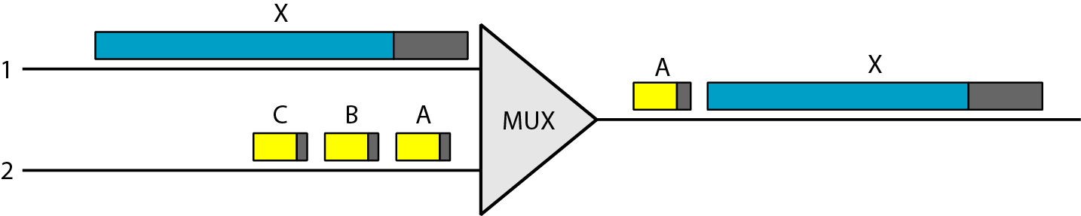
Figure 1 Multiplexing using different frame sizes
18.<number>

Slide 8
Continue…
Cell Networks
  frame internetworking are solved
  A cell is a small data unit of fixed size.
  basic unit of data exchange
  frames of different sizes ➔ reach the cell network ➔ split into equal length and are loaded into cells
  cells are then multiplexed with other cells
  handle real-time transmissions, such as a phone call
18.<number>

Slide 9

Note
A cell network uses the cell as the basic unit of data exchange.
A cell is defined as a small, fixed-size block of information.
18.<number>

Slide 10
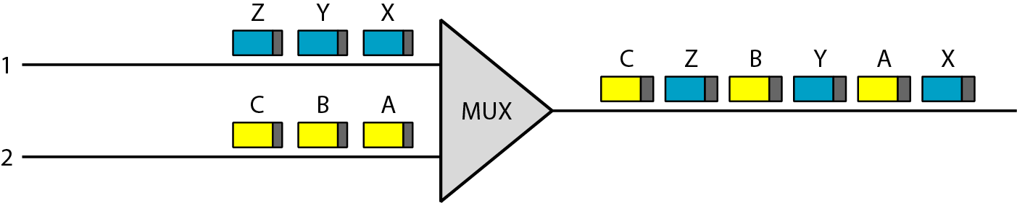
Figure 2 Multiplexing using cells
18.<number>

Slide 11
Continue…
Asynchronous TDM
  multiplex cells coming from different channels
  uses fixed-size slots (size of a cell)
  fill a slot with a cell from any input channel
  slot is empty if none of the channels has a cell to send
18.<number>

Slide 12
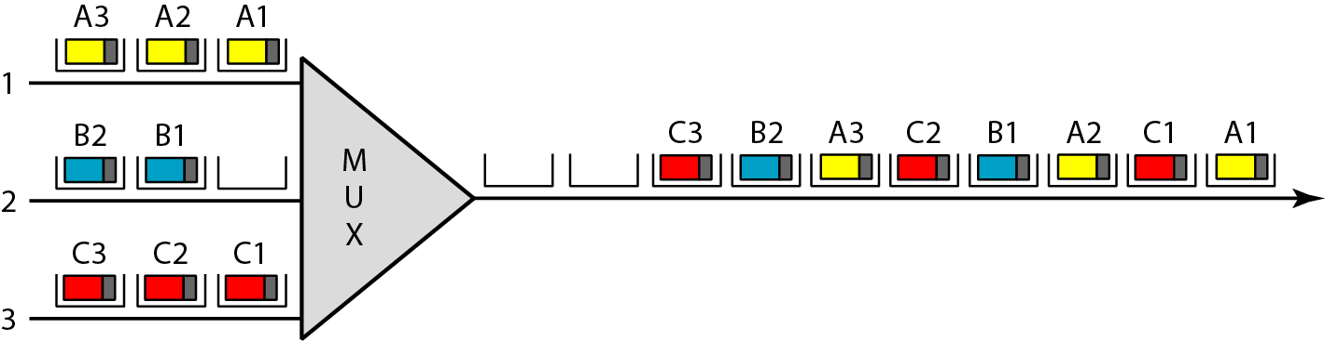
Figure 3 ATM multiplexing
18.<number>

Slide 13
Architecture
User → end points
UNI → user-to-network interface
NNI → network-to-network interfaces
18.<number>

Slide 14
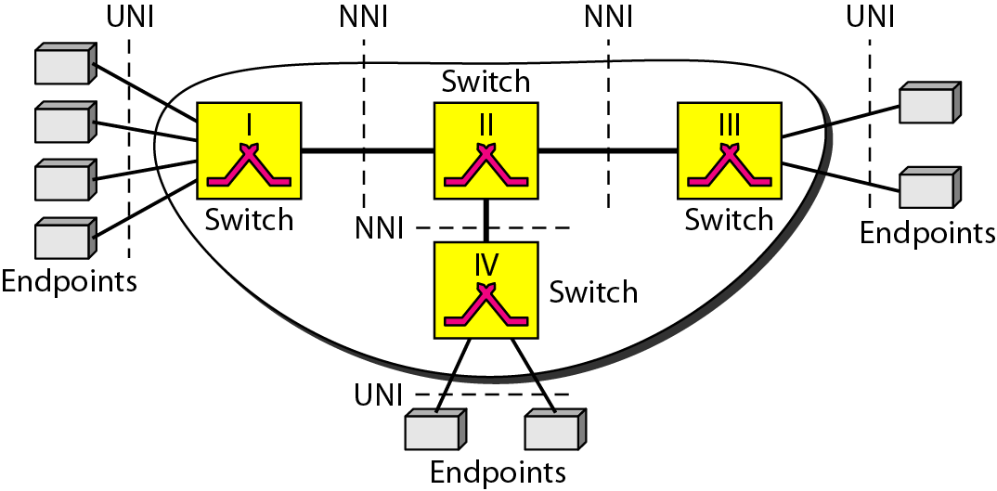
Figure 4 Architecture of an ATM network
18.<number>

Slide 15
Virtual Connection
A transmission path (TP) ➔ physical connection (wire, cable, satellite, and so on) ➔ between an endpoint and a switch or between two switches
Cell networks are based on virtual circuits (VCs).
cells belonging to a single message follow the same virtual circuit and remain in their original order until they reach their destination.
18.<number>

Slide 16
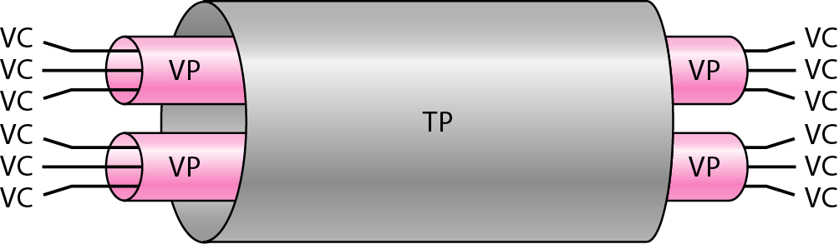
Figure 5 TP, VPs, and VCs
18.<number>

Slide 17
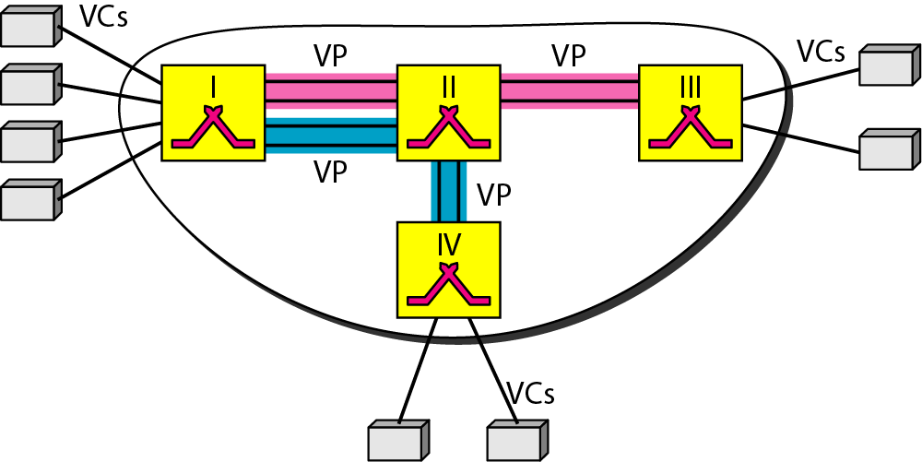
Figure 6 Example of VPs and VCs
18.<number>

Slide 18
Note
Note that a virtual connection is defined by a pair of numbers:
the VPI and the VCI.
18.<number>

Slide 19
Identifier
VPI - Virtual path identifier
  Defines specific VP
  VPI same for VCs that are bundled
VCI - Virtual circuit identifier
  Defines particular VC inside VP
18.<number>

Slide 20
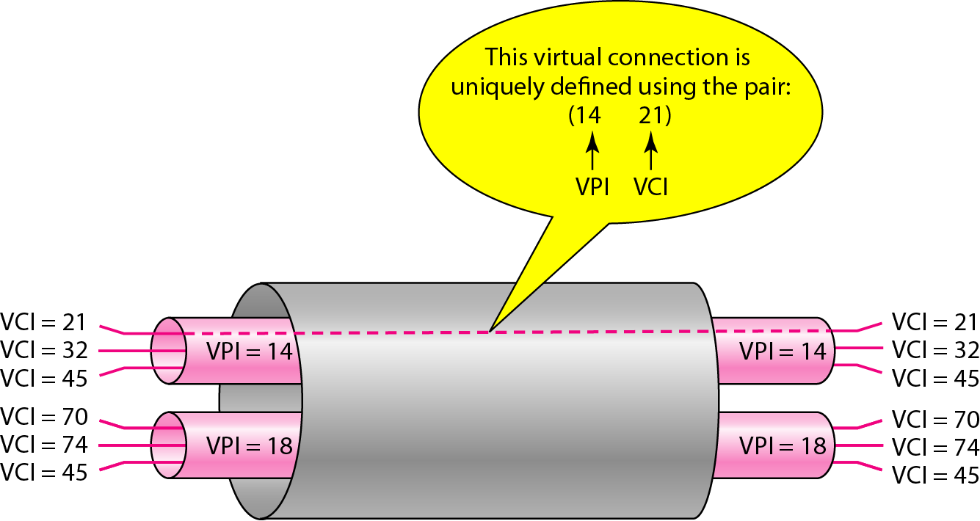
Figure 7 Connection identifiers
18.<number>

Slide 21
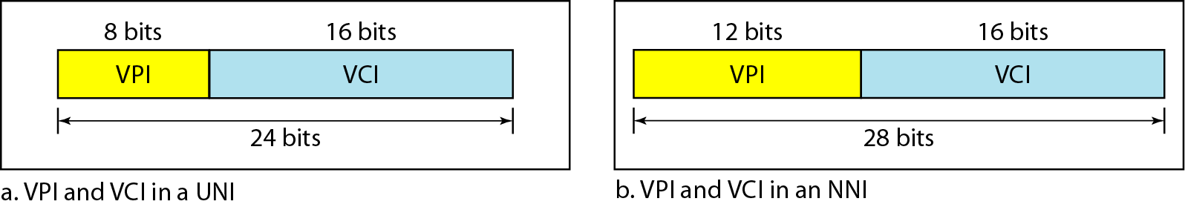
Figure 8 Virtual connection identifiers in UNIs and NNIs
18.<number>

Slide 22
Identifier
switches in a typical ATM network are routed using VPIs.
switches at the boundaries of the network, those that interact directly with the endpoint devices, use both VPIs and VCIs.
18.<number>

Slide 23
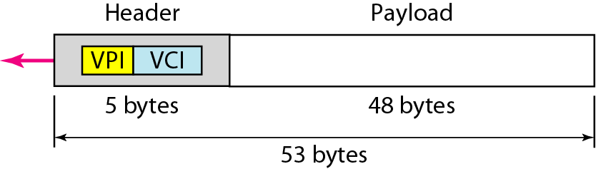
Figure 9 An ATM cell
18.<number>

Slide 24
Connection Establishment and Release
ATM uses two types of connections:
  PVC - permanent virtual-circuit connection
    established between two endpoints by the network provider
  SVC - switched virtual-circuit connection
    Each time a new virtual circuit must be established
    ATM Can’t do itself
    depends on the network layer protocol
18.<number>

Slide 25
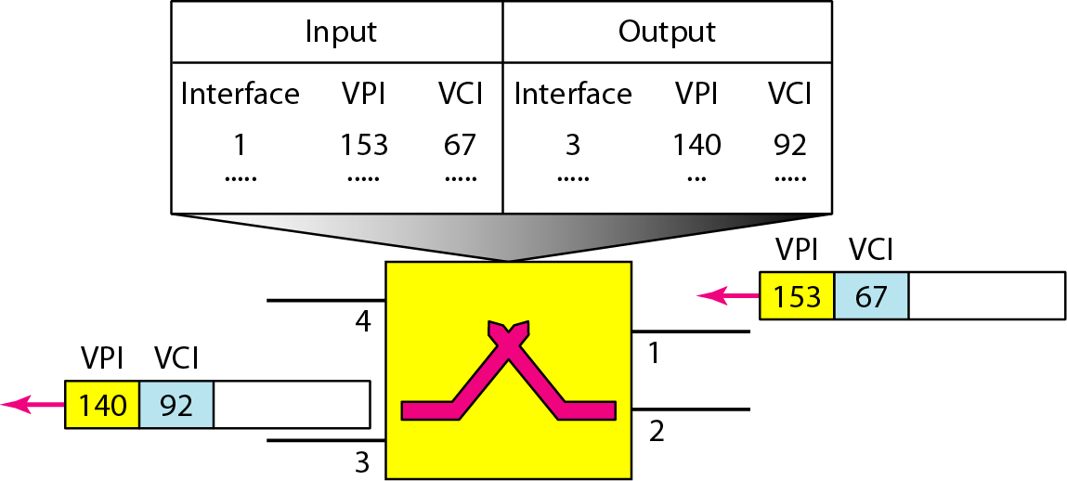
Figure 10 Routing with a switch
18.<number>

Slide 26
ATM Layers
Three layers
  Application adaptation layer
  ATM layer
  physical layer
Endpoint ➔ All three layers
Switches ➔ bottom two layers
18.<number>

Slide 27
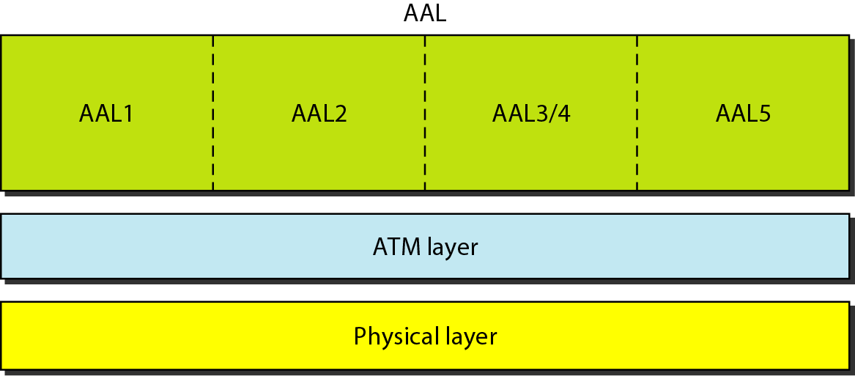
Figure 11 ATM layers
18.<number>

Slide 28
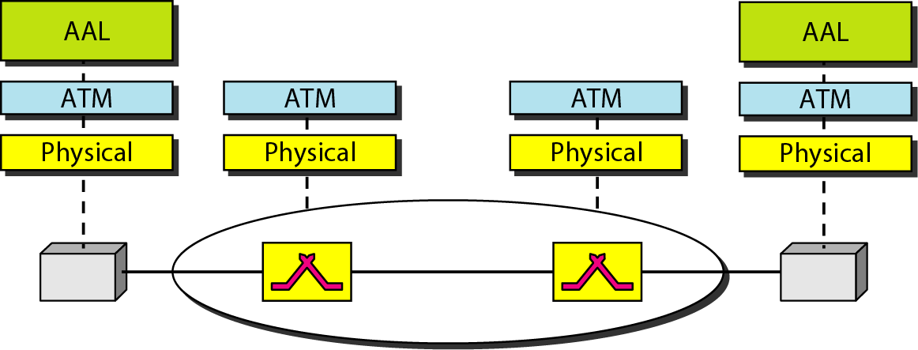
Figure 12 ATM layers in endpoint devices and switches
18.<number>

Slide 29
ATM Layers
Physical layer
  Like Ethernet and wireless LANs, ATM cells can be carried by any physical layer carrier.
18.<number>

Slide 30
ATM Layers
ATM layer
  routing,
  traffic management,
  switching,
  Multiplexing
AAL → 48 byte segment → ATM → 53 byte (48 byte + 5 byte header)
18.<number>

Slide 31
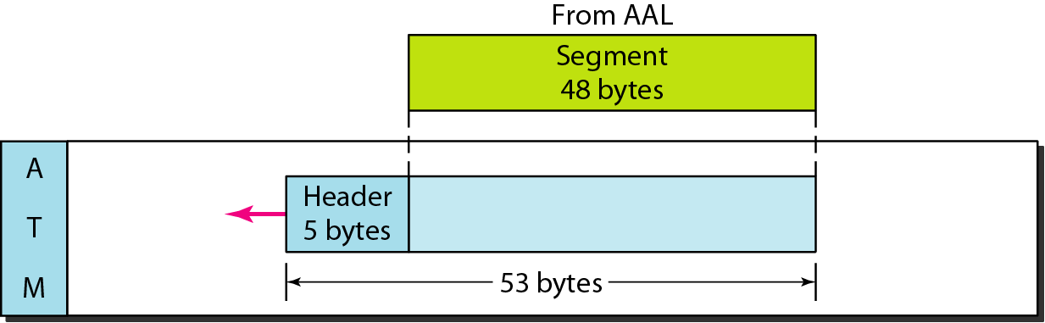
Figure 13 ATM layer
18.<number>

Slide 32
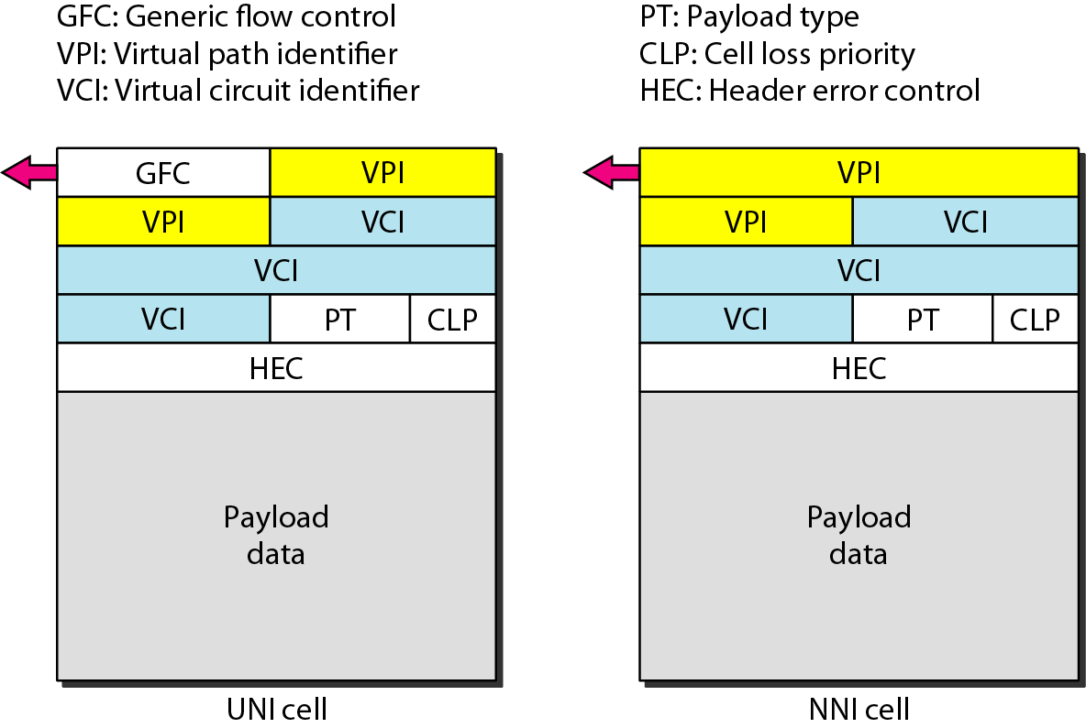
Figure 14 ATM headers
18.<number>

Slide 33
ATM headers
Generic flow control (GFC) → 4 bit → Flow control → UNI level
Virtual path identifier (VPI)
  8-bit field in a UNI cell
  12-bit field in an NNI cell
Virtual circuit identifier (VCI) → 16 bit in both
Payload type (PT) → 3 bit
18.<number>

Slide 34
ATM headers (Continue..)
Cell loss priority (CLP)
  1 bit
  For congestion control
Header error correction (HEC)
  computed for the first 4 bytes of the header
  CRC with divisor x^8 + x^2 + x + 1
  correct single-bit errors and a large class of multiple-bit errors
18.<number>

Slide 35
Application Adaptation Layer
To enable two ATM concepts
ATM must accept any type of payload, both data frames and streams of bits
  Frames → from upper layer
  Bit stream → chunks → encapsulated at ATM layer
18.<number>

Slide 36
Application Adaptation Layer(Continue..)
Two Sublayer:
segmentation and reassembly (SAR) sublayer
  Payload → 48 byte segment → At destination → recreate original ➔ Using AAL sublayer
convergence sublayer (CS)
  To guarantee the integrity of the data
18.<number>

Slide 37
Version of AAL
AAL1,
AAL2,
AAL3/4,
AAL5.
Today → AAL1 - streaming audio & video
→ AAL5 – Data Communication
18.<number>

Slide 38
AAL1
supports applications that transfer information at constant bit rates → video and voice
allows ATM to connect existing digital telephone networks
SAR add 1 byte header
  Two fields
    Sequence number (SN) – 4 bit
    Sequence number protection (SNP) – 4 bit → protect SN
18.<number>

Slide 39
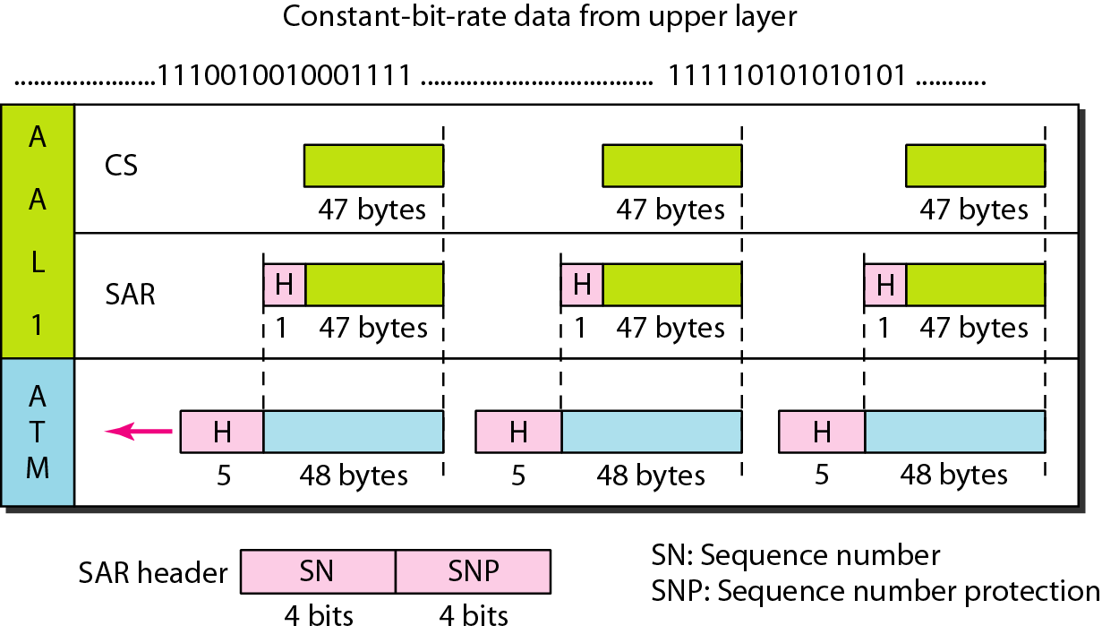
Figure 15 AAL1
18.<number>

Slide 40
AAL2
support a variable-data-rate bit stream, but it has been redesigned.
now used for low-bit-rate traffic and short-frame traffic such as audio (compressed or uncompressed), video, or fax.
short frames into one cell.
18.<number>

Slide 41
AAL2 (Continue..)
CS layer overhead consists of five fields:
Channel identifier (CID): 8-bit field defines the channel (user) of the short packet
Length indicator (LI). The 6-bit LI field indicates how much of the final packet is data.
Packet payload type (PPT). The PPT field defines the type of packet.
18.<number>

Slide 42
AAL2 (Continue..)
User-to-user indicator (UUI). The UUI field can be used by end-to-end users.
Header error control (HEC). The last 5 bits is used to correct errors in the header.
18.<number>

Slide 43
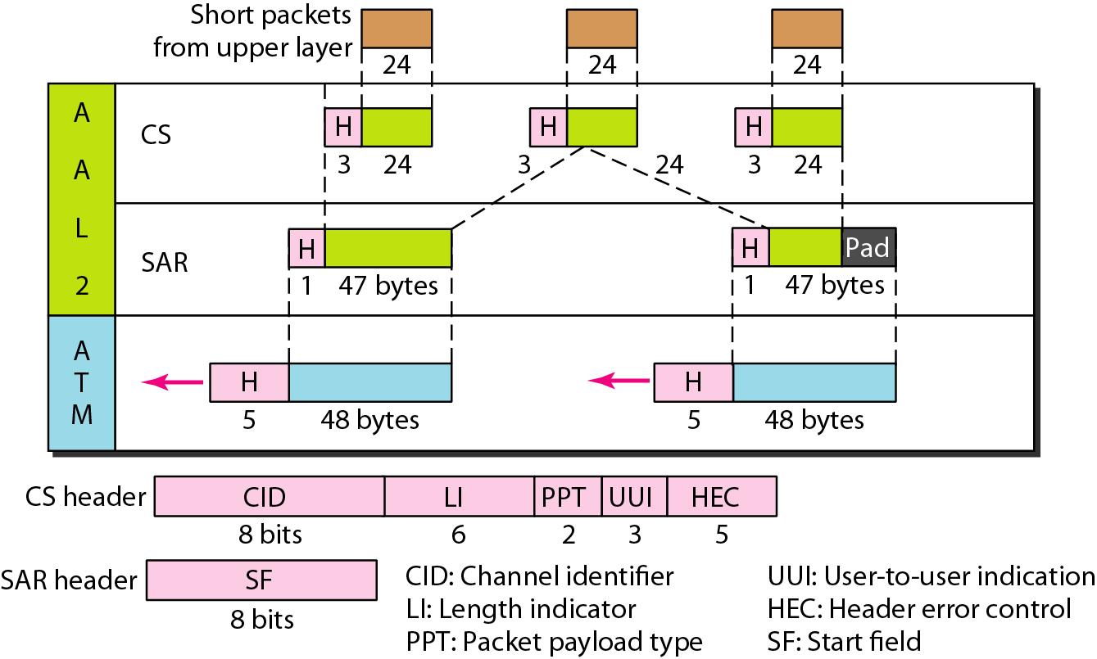
Figure 16 AAL2
18.<number>

Slide 44
AAL3/4
Initially, AAL3 was intended to support connection-oriented data services
AAL4 to support connectionless services.
fundamental issues of the two protocols were the same ➔ combined
CS layer header and trailer consist of six fields:
Common part identifier (CPI). The CPI defines how the subsequent fields are to be interpreted. The value at present is O.
18.<number>

Slide 45
AAL3/4 (Continue..)
Begin tag (Btag). The value of this field is repeated in each cell to identify all the cells belonging to the same packet. The value is the same as the Etag.
Buffer allocation size (BAsize). The 2-byte BA field tells the receiver what size buffer is needed for the coming data.
Alignment (AL). The I-byte AL field is included to make the rest of the trailer 4 bytes long.
18.<number>

Slide 46
AAL3/4 (Continue..)
Ending tag (Etag). The I-byte ET field serves as an ending flag. Its value is the same as that of the beginning tag.
Length (L). The 2-byte L field indicates the length of the data unit.
18.<number>

Slide 47
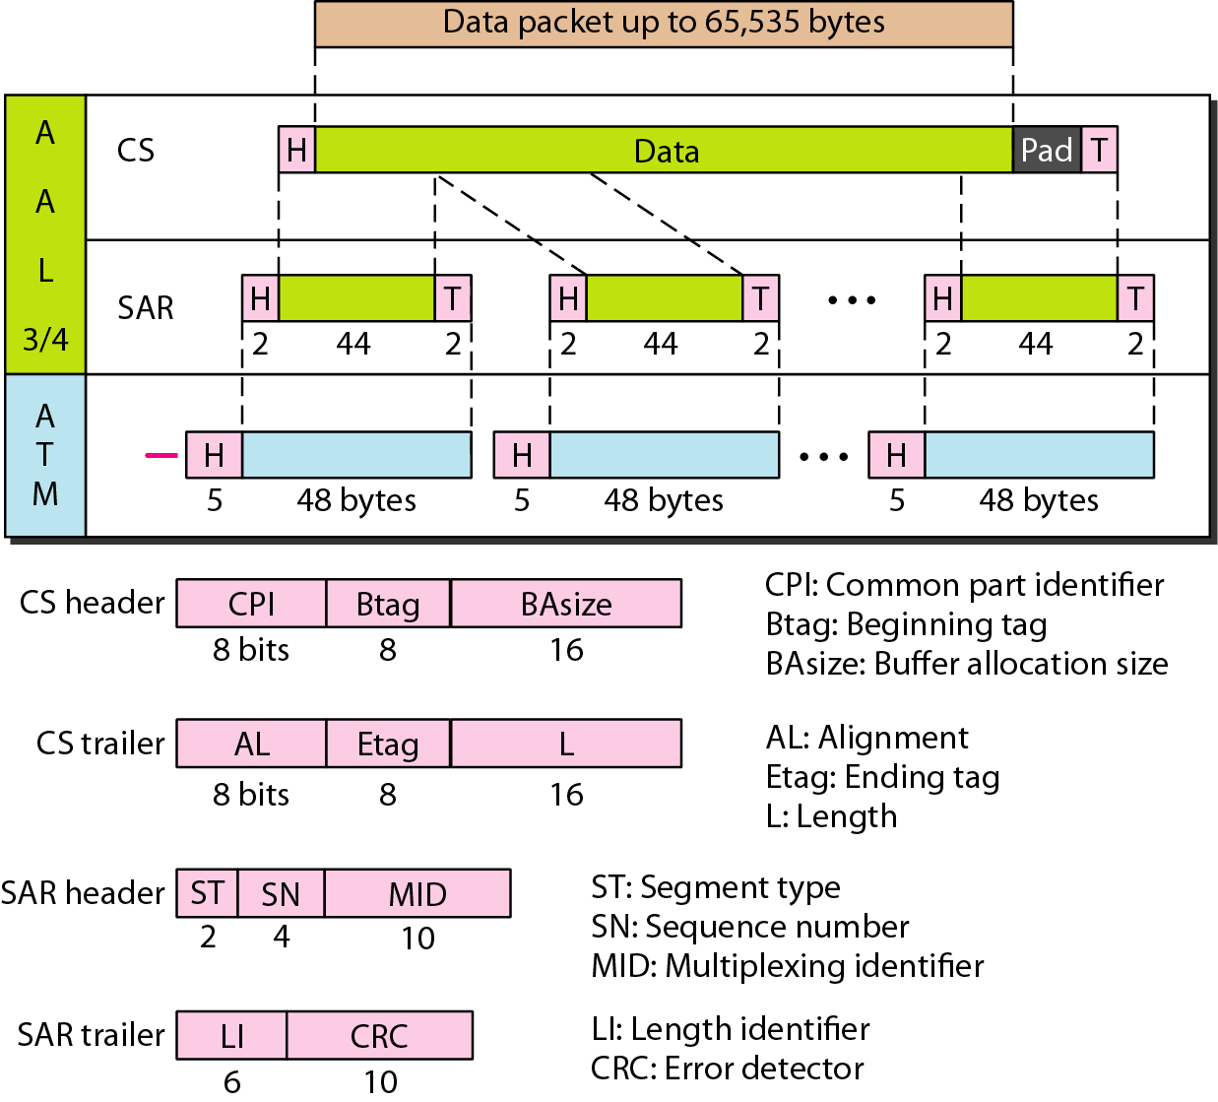
Figure 17 AAL3/4
18.<number>

Slide 48
AAL5
AAL3/4 provides comprehensive sequencing and error control mechanisms that are not necessary for every application
AAL5 assumes that all cells belonging to a single message travel sequentially and that control functions are included in the upper layers of the sending application.
18.<number>

Slide 49
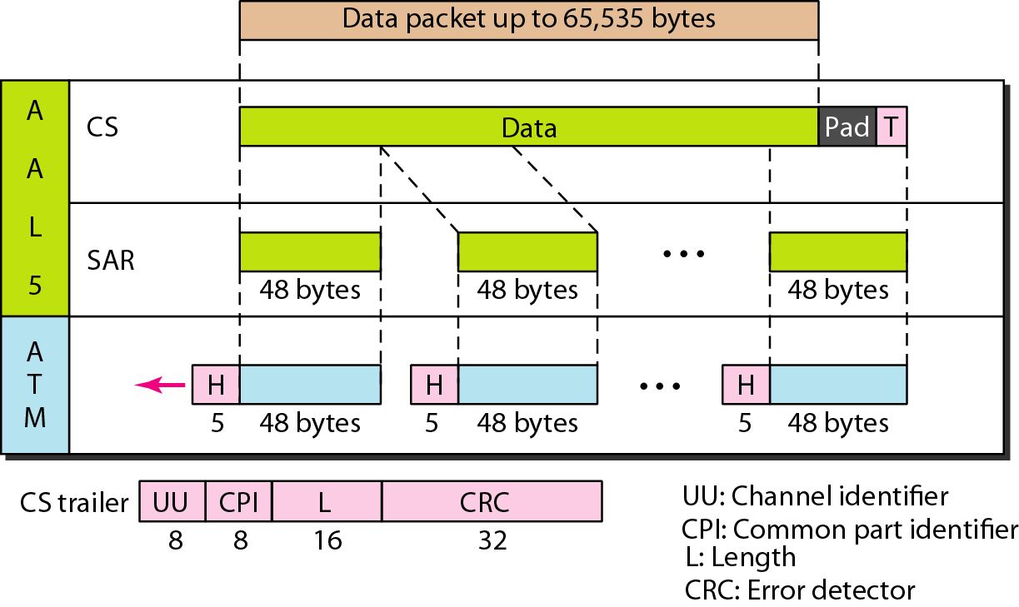
Figure 18 AAL5
18.<number>

